Slide 1

A Tester's Guide to
Claude Code
From Setup to Scripting
Adonis Celestine Senior Director, Global Automation Practice Lead, Applause
Taras Lytvyn AI-first Test Automation Architect, Lead SDET, Applause

Slide 2

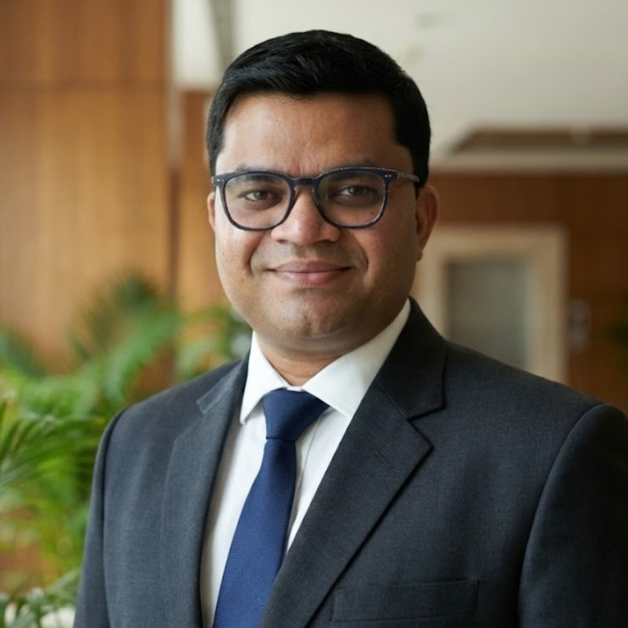

YOUR SPEAKERS
1.5M+
QA community
200+
Countries & territories
150+
Languages
Adonis Celestine
Taras Lytvyn
10M+
Devices worldwide
Author, International Speaker
Global Head of Automation
AI-first Test Automation Architect
Lead SDET
200K+
Bugs found a year
Notes:
Quick intros, 30 seconds each. Adonis: automation practice and the book. Taras: builds AI-first test frameworks day to day, and built Clappy. Then one line on Applause and its crowd.

Slide 3

QUICK QUESTION
Who is Claude named after?
Hint: 1948
Notes:
Audience moment. Ask the room: who is Claude named after? Let them shout guesses and wait a beat before you click. If nobody gets it, give the hint: 1948, the year a paper started the information age.

Slide 4
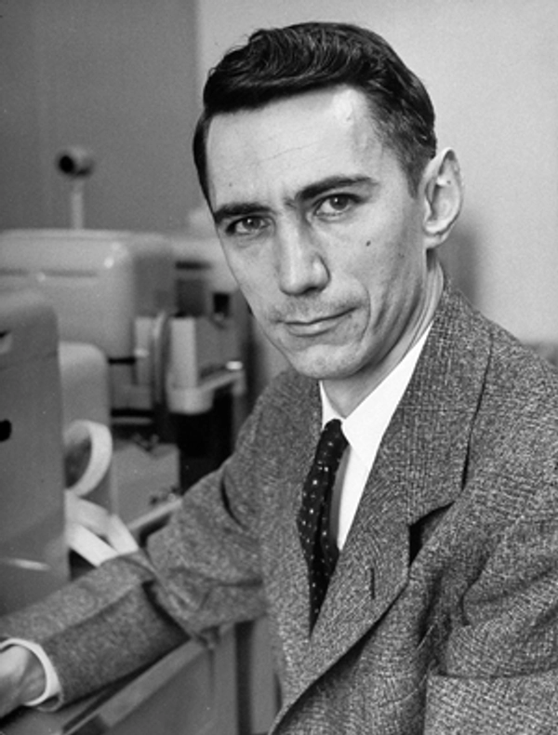
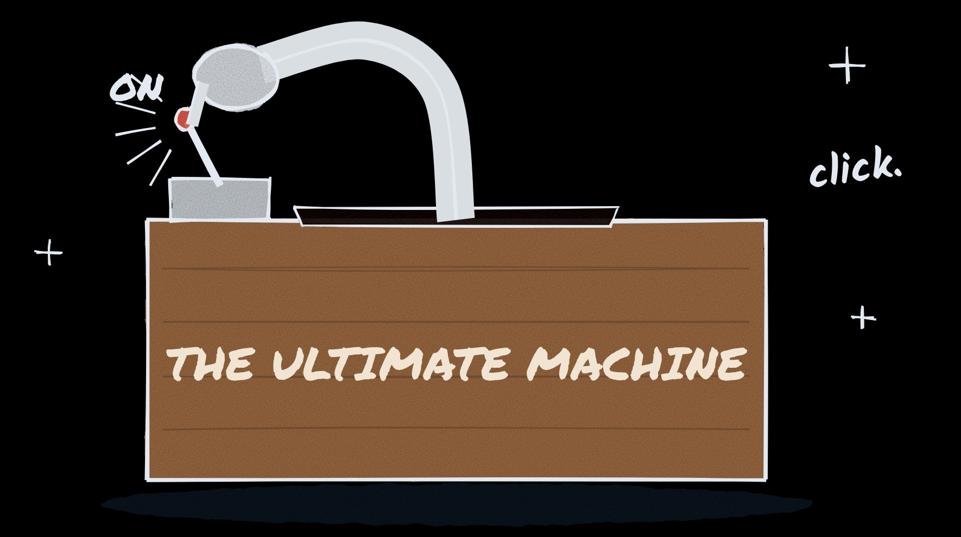
CLAUDE SHANNON · 1916–2001
1
Founded information theory in 1948.
2
Rode a unicycle down the Bell Labs corridors. While juggling.
3
Kept a machine on his desk whose only job was to switch itself off.
Switch it on.
It switches itself off.
Every single time.
The first 100% reproducible bug.
Today: getting a clean signal out of a noisy AI.
Notes:
Icebreaker, about 40 seconds. Yes, Claude Shannon. Three things about him. One: in 1948 he founded information theory, the maths behind every bit you have ever sent. Two: he rode a unicycle through the corridors of Bell Labs, juggling. Three: he kept a machine on his desk, the Ultimate Machine, which his colleague Marvin Minsky came up with. You flip the switch on, the lid opens, a hand comes out and switches it off. Every single time. Pause. As testers, we finally have it: the first 100 percent reproducible bug. Then pivot: his serious question is ours today, how do you get a clean signal through a noisy channel?
Before we meet the tool, a word about its name. Claude is named after Claude Shannon. Honest caveat: Anthropic never made a big official statement, but the New York Times reported it as an homage, and for a QA talk it is a perfect name. In 1948 Shannon wrote A Mathematical Theory of Communication and founded information theory. His core problem: how do you get a clean signal through a noisy channel, and correct the errors the noise introduces? Hold that phrase. A flaky test is a noisy channel. Under the noise is one real signal, does the software work, and recovering it is the whole job. Shannon's answer was not to shout louder or re-run until it looked right. It was to add structure that catches and corrects the errors. That is this entire talk. The AI we are about to use is fast, and on its own it is noisy: it bluffs. So we give it Shannon's trick: real docs instead of guesses, rules it has to follow, a human on the last mile. We take a noisy channel and make it trustworthy. The tool is named after the man who proved that was possible. Let us use it properly.

Slide 5
Why we chose Claude Code for test automation
SWE-bench Verified
ISSUE SOLVE RATE
Context Horizon
TOKEN CAPACITY
Real-world GitHub issue resolution without regression
Total repository & test log working memory per session
Claude Code
80.8%
Claude Code
1,000,000
Gemini CLI / Antigravity
78.8%
Gemini CLI / Antigravity
1,000,000
OpenAI Codex
70.3%
OpenAI Codex
200,000
GitHub Copilot
60.5%
GitHub Copilot
128,000

Slide 6




Three commands. Your own cloud.
1 INSTALL, IN YOUR TEST REPO
2 WHY COMPANIES RUN IT ON THEIR OWN CLOUD
your-test-repo
Company login
Your data
# install (macOS, Linux)
$ curl -fsSL https://claude.ai/install.sh | bash
# start a session
$ claude
# writes a first CLAUDE.md
> /init
Cloud IAM or Entra ID. No personal API keys.
On Bedrock only AWS sees it. Not Anthropic.
One bill
Your region
On your cloud invoice, split by team.
You choose it, and every call is logged.
Same Claude Code, one setting: CLAUDE_CODE_USE_BEDROCK=1 or _VERTEX · _FOUNDRY
Notes:
On screen we cut it to the essentials; the full detail: Company login means AWS IAM, Google Cloud IAM or Entra ID, no personal API keys. Your data: on Bedrock only AWS sees it, Anthropic has no access. One bill: on your AWS, Google Cloud or Azure invoice, split by team. Your region: you choose it, and every call is logged. Same Claude Code, one setting: CLAUDE_CODE_USE_BEDROCK=1 (or _VERTEX, _FOUNDRY). Caveat to say out loud: some features stay Anthropic-only, e.g. web search on Bedrock.
Windows: PowerShell installer; or npm install -g @anthropic-ai/claude-code. Who sees your data: Bedrock, only AWS (AWS docs: model providers have no access to prompts and completions). Google Cloud: run by Google. Foundry: run by Anthropic. None of them train on it. The region has to be configured, it is not automatic. Trade-off: some features are Anthropic-only (web search on Bedrock, fast mode, cloud sessions) and the newest models can arrive later. Permission modes: Shift+Tab cycles ask-before-every-change, accept edits, and plan mode (it only proposes, you approve).

Slide 7






The Foundation & Building blocks
BUILDING BLOCKS
Skill
Subagent
Hook
MCP Server
Plugin
PLAYBOOK
WORKER
GUARDRAIL
TOOL PLUG
BUNDLE
RESTS UPON FOUNDATION
THE FOUNDATION
Context
Memory
WORKING MEMORY
PERSISTENT STATE

Slide 8

Context
THE FOUNDATION · 1 OF 2
Working memory: everything Claude can see right now.
KEEP IT CLEAN
/context
see what is filling it
/compact [focus]
summarise, keep what matters
auto-compact
runs on its own when nearly full
/clear
start fresh for a new task
subagents
read big things, return a summary
TOOLS THAT SAVE TOKENS
caveman
Terse replies, fewer tokens. Also shrinks CLAUDE.md.
Context7
Current Playwright/Appium docs for your version.
Serena
Finds code by symbol, not by reading whole files.
Repomix
Packs a repo into one AI-friendly file.
Notes:
Tools in full: caveman gives terse replies and fewer tokens; caveman-compress shrinks CLAUDE.md. Context7 serves current library docs, so you get correct Playwright/Appium syntax for your version. Serena finds code by symbol instead of reading whole files. Repomix packs a repo into one AI-friendly file with token counts.
For QA: a 5,000-line test log pasted into chat eats your context, filter it first, or let a subagent read it.

Slide 9
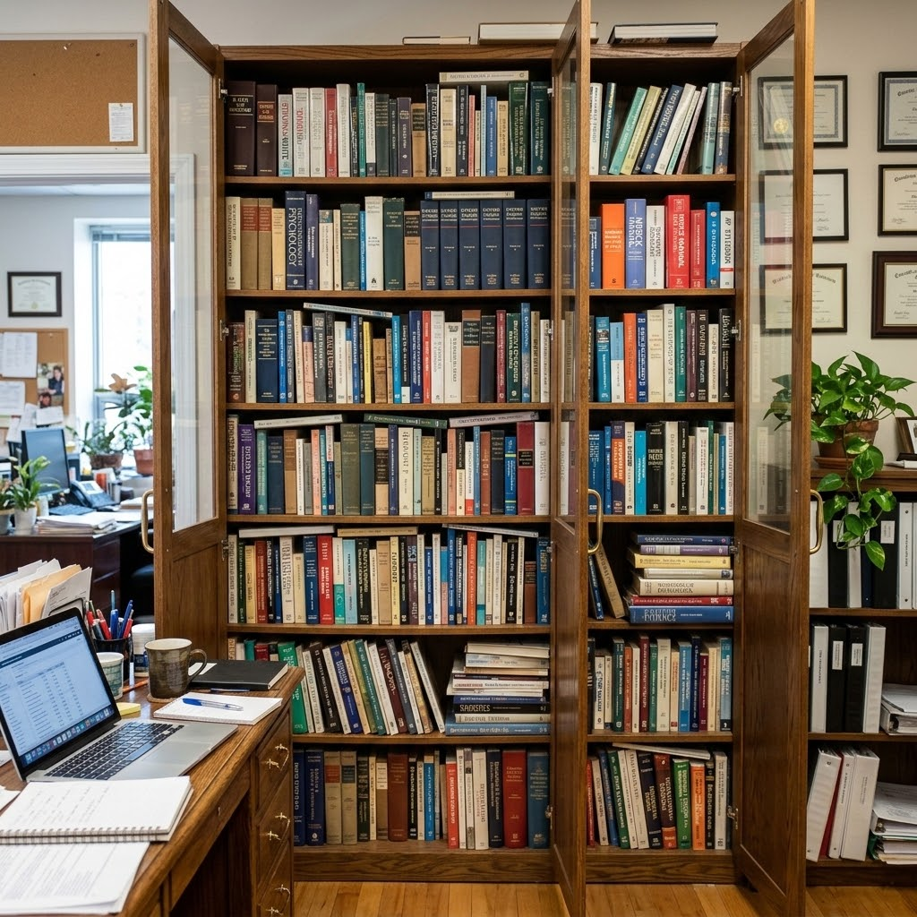
Memory
THE FOUNDATION · 2 OF 2
Stays on your machine. To share it, commit it: git is the sync.
WHERE IT LIVES
Organisation
managed CLAUDE.md (by IT)
You, all projects
~/.claude/CLAUDE.md
Team, one repo
./CLAUDE.md + .claude/rules/
Several repos
@~/team-standards/qa.md
Past sessions
claude --continue / --resume
TOOLS WE USE
claude-mem
Searchable history of past sessions. We use it daily.
mem0
Long-term memory for your own QA agents.
basic-memory
Plain Markdown notes, versioned next to the repo.
Notes:
Tools in full: claude-mem is a searchable history of past sessions; it remembers last week's flaky-test causes, and we use it daily. mem0 is a long-term memory layer for agents: known defects, test-data rules, also for your own QA agents. basic-memory keeps notes as plain Markdown you can review and version next to the test repo. (Repomix moved to the Context slide only.)

Slide 10
Building Blocks in Action: A QA Example
1
MCP Server
Plugs Claude into outside tools & live runtimes
Playwright / Appium
Called whenever Claude needs to inspect an external app
ADDS A TOOL
Inspect real browser DOM & mobile UI
2
Skill
Markdown playbooks (SKILL.md) for repeatable tasks
/api-tests
Loaded on demand or invoked directly via /command
SAYS HOW
Generates tests using team conventions
3
Hook
Deterministic scripts triggered automatically by events
block rm -rf
Enforces hard rules on tool calls, edits, and commands
ALWAYS RUNS
Blocks destructive file or DB operations
4
Subagent
Helper agent with isolated memory and tailored tools
test-reviewer
Processes large diffs and logs without filling your context
WORKS ON SIDE
Catches flaky sleeps & weak assertions
5
Plugin
Distributable package bundling skills, agents, hooks & MCP
qa-toolkit
Installed once with /plugin to share across team repos
BUNDLES ALL
One-command team distribution

Slide 11






Example building block: MCP
MCP (Model Context Protocol) is a standard plug: install a server, and Claude gets new tools.
Playwright MCP
Appium MCP
Mobile-mcp
Web: a real browser, clicks, network.
Android & iOS, emulators or real devices.
Open-source iOS & Android automation.
GitHub
Jira & Confluence
Clappy MCP (Applause)
Issues and PRs from failed runs.
Atlassian MCP: stories, bugs, test plans.
Recorded flow → Playwright framework.
Use a CLI when…
Use MCP when…
Repeatable jobs: tests, lint, CI.
No shell: chat apps, IDE panels.
Claude Code drives a browser: playwright-cli.
Hosted tools with login: Jira, Confluence.
Huge output: filter the logs first.
Live exploration: one step at a time.
SAME BROWSER
TASK, TOKENS
Playwright CLI
≈27k
≈4×
fewer with the CLI
Playwright MCP
≈114k
Typical QA flow: explore with Playwright MCP → save it as a .spec.ts → run it with the CLI from then on.
Notes:
CLI vs MCP in full: use a CLI or script when the job is deterministic (run tests, lint, parse logs), when it must run the same way in CI, when a good CLI already exists (gh, aws, playwright-cli), and when the output is big, so filter it before Claude reads it. Use MCP when the agent needs live state across steps such as a browser session, when the work is exploratory and the next step depends on what it sees, when it is a hosted service with login (OAuth) like Jira or test management, and when there is no shell, as in chat apps and IDE panels.
Token cost, MCP vs CLI: on the same browser task, Microsoft's benchmark (as reported by TestDino) measured roughly 114,000 tokens with Playwright MCP and about 27,000 with Playwright CLI, about 4x fewer. Why: MCP loads all its tool definitions up front and sends the page's accessibility snapshot back into the context after every action. The CLI (@playwright/cli, separate repo microsoft/playwright-cli) writes snapshots to files on disk, and Claude reads only what it needs. Microsoft's Playwright MCP README now says coding agents increasingly favour CLI plus skills; MCP stays useful for agents with no shell and long exploratory loops. Your numbers depend on the pages and the length of the session.

Slide 12
Example building block: Skills and Sub Agents
.claude/skills/api-tests/SKILL.md
.claude/agents/test-reviewer.md
---
name: api-tests
description: Write Playwright API tests
(no browser) based on the team docs.
Use when asked to write API tests.
---
1. Search the team docs first
2. Cover every error code; keep checking
async results until they settle
3. Run them, report which doc each
is based on
---
name: test-reviewer
description: Reviews new tests for
hard waits, weak asserts, flakiness.
tools: Read, Grep
---
Works in its own working memory and reports back a short verdict.
Why skills scale: only each skill's short description is loaded until a task needs it, many skills cost very little.
Where to get skills
1
anthropics/skills: webapp-testing (Playwright)
2
qaskills.sh: hundreds of QA skills, npx qaskills add …
3
Plugin marketplaces: /plugin

Slide 13
Best practices
Ground it in your docs · Give it rules
Notes:
Remember Shannon: you don't fix a noisy channel by re-running until it looks right, you add structure. Two best practices do that for Claude Code. One: ground it in your docs, so it reads instead of guesses. Two: give it rules it has to follow. Neither is a new building block; both are built from the blocks we just saw.

Slide 14
Inside RAG: how it finds the right page
INDEXING · ONCE PER PROJECT
1
Your docs
2
Chunk
3
Embed
4
Store
Runbooks, specs, tickets, incidents
→
Passages of a few hundred tokens, small overlap
→
Each chunk becomes a vector of 384 numbers
→
Vector database plus a BM25 keyword index
corpus/
npm run index
all-MiniLM-L6-v2
Chroma + BM25
RETRIEVAL · EVERY TIME CLAUDE CALLS search_docs
BM25 KEYWORDS
Embeddings MEANING
Ranks chunks by matching words. Rare words count more.
Finds the chunk vectors nearest to the question.
search_docs(“QA-1432 payment-status”)
search_docs(“why is checkout slow?”)
✓ Finds the ticket and the test with that exact ID
✓ Finds “up to 8 s at peak”, with no shared words
Best at: exact IDs, error codes, locators
Best at: synonyms, plain-English questions
Hybrid: merge both rankings → top chunks + their sources → into Claude's prompt
Notes:
Voice-over, what RAG is: a generic AI guesses how your app works; RAG reads your Jira tickets and API specs first. Retrieve the right passages, augment the prompt with them, then generate a grounded answer or fix instead of a generic guess.
Indexing happens once per project, not on every question. One: export your docs into a folder. Two: chunking. We split each doc into passages of a few hundred tokens, with a little overlap, so a fact like "up to 8 s at peak" is never cut in half. Chunk too big and the search gets vague; too small and you lose context. Three: embedding. A small model, all-MiniLM-L6-v2 in our demo, running locally and free, turns each chunk into 384 numbers. Chunks that mean similar things end up close together in that space. Four: store the vectors in Chroma, and build a BM25 keyword index over the same chunks.
Worked example of one chunk, from our payment runbook: "Payment confirms asynchronously: usually 1-3 s, up to 8 s at peak. Tests must wait for the status confirmed, not a fixed time."
Every time Claude calls search_docs, two searches run. BM25 is classic keyword ranking: it rewards chunks that contain the query words, gives rare words like a ticket ID more weight than common ones, and normalises for chunk length. It is unbeatable for exact strings: QA-1432, an error code, a data-testid. Embeddings search by meaning: the question is turned into a vector with the same model, and we take the nearest chunks by cosine similarity. "Why is checkout slow?" finds the runbook line about 8 s at peak even though the words differ. Hybrid search merges both rankings, for example with reciprocal rank fusion, and hands the top few chunks plus their source file names to Claude. That is why our fix could name the doc it used.
Set it up once per project, five things in the test repo: corpus/ for your doc exports; npm run chroma starts Chroma, a free open-source search database (Docker); npm run index splits your docs and stores them; .mcp.json adds the search_docs tool to Claude Code; CLAUDE.md says call search_docs before fixing a test. Our demo's tools, and alternatives: Chroma (vector store; or pgvector, Qdrant, OpenSearch); all-MiniLM-L6-v2 embeddings via Transformers.js, local and free (or OpenAI, Voyage, Bedrock Titan); BM25 for exact words (or Elasticsearch/OpenSearch); a 40-line MCP server built with the MCP SDK. Commands in the demo repo: npm run chroma, npm run index; .mcp.json entry 'team-knowledge' runs mcp/rag-server.js.

Slide 15


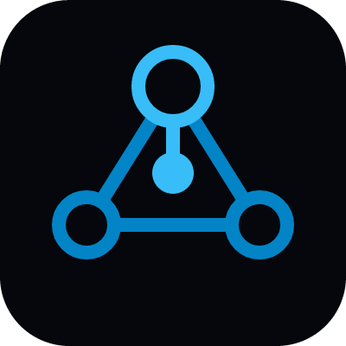

The 4 Evolution Stages of RAG
Naive RAG
Advanced RAG
GraphRAG
Agentic RAG
Single-pass lookup. Best for querying a QA wiki or fetching a single known Jira ticket.
Reranks CI logs + Confluence to find the exact root cause of a flaky test failure.
Maps knowledge graphs to link requirements, test coverage, and code defects.
Autonomous testing loops: writes test, runs it, reads logs, fixes code, repeats until passing.
Fastest • Fragile with noise
High Precision • Production default
Deep Reasoning • Gap Analysis
Iterative • Self-Healing
WHERE TO START
Start simple: no index
The Atlassian MCP server searches Confluence and Jira live.
Our demo setup
Chroma plus a small search_docs MCP server. Local and free.
Managed
Bedrock Knowledge Bases or Vertex AI RAG Engine do the indexing.

Slide 16

/karpathy-guidelines: one file, four rules
Andrej Karpathy wrote down how AI fails at coding. This free skill turns those notes into rules Claude Code follows.
SCAN TO GET IT
GET IT: TWO COMMANDS
in Claude Code
> /plugin marketplace add multica-ai/andrej-karpathy-skills
> /plugin install andrej-karpathy-skills@karpathy-skills
github.com/multica-ai/
andrej-karpathy-skills
THE FOUR RULES, ONE PER SLIDE NEXT
1
Think first
2
Keep it simple
3
Touch only the task
4
Prove it
Notes:
On screen we only introduce it; the next four slides take one rule each. What it fixes: AI assumes silently, overcomplicates, edits what it should not, and says done without proof. What you get on a real project: Think first, it states its assumptions and asks instead of guessing. Keep it simple, the minimum code, no extra helpers, retries or options. Touch only the task, small diffs, one test fix does not rewrite the framework. Prove it, it shows how it checked: passed 30/30, not just done.
What it is: github.com/multica-ai/andrej-karpathy-skills (moved from forrestchang/andrej-karpathy-skills; the README's install commands still use the old name, GitHub redirects). A single CLAUDE.md-style rule file, community-written, derived from Andrej Karpathy's post on LLM coding pitfalls: models make wrong assumptions and run with them, overcomplicate code, and change code they don't understand as side effects. Install as a plugin (two commands on the slide), or per project: append its CLAUDE.md to yours. Use it by name in a prompt ('follow /karpathy-guidelines') or keep it on for every task. Real run on our flaky test with no team docs: plain prompt silently picked a 10 s timeout; with the skill, one changed line, proved 30/30, and 'I don't know how fast your CI is'. Next: the checkout fix, rule by rule.

Slide 17
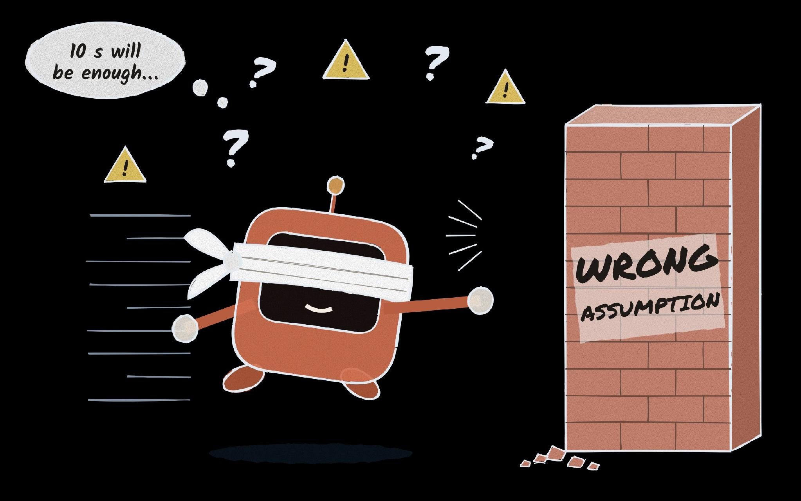
Problem 1 — Wrong Assumptions
THE RULE · 1 OF 4
Think first
State your assumptions. If something is unclear, ask before writing any code.
TESTING EXAMPLE
Task Fix the flaky checkout test.
✗ Without Silently sets a 10 s timeout, picked from what it saw on this laptop.
✓ With the rule Asks first: “I don't know how fast your CI is.”
IMPACT ON YOUR TEST PROJECT
Guesses surface as questions your docs or team can answer, not as failures in CI.
/karpathy-guidelines
Notes:
Rule 1, think first. The most common failure: the model makes an assumption and runs with it, blindfolded. On our flaky checkout test with no team docs, the plain prompt measured the local shop and silently set a 10 second timeout. It fails the day the gateway takes 12. With the guideline on, Claude changed one line and said out loud: I don't know how fast your CI is. That sentence is the win. A stated assumption is something your docs, or you, can correct.

Slide 18
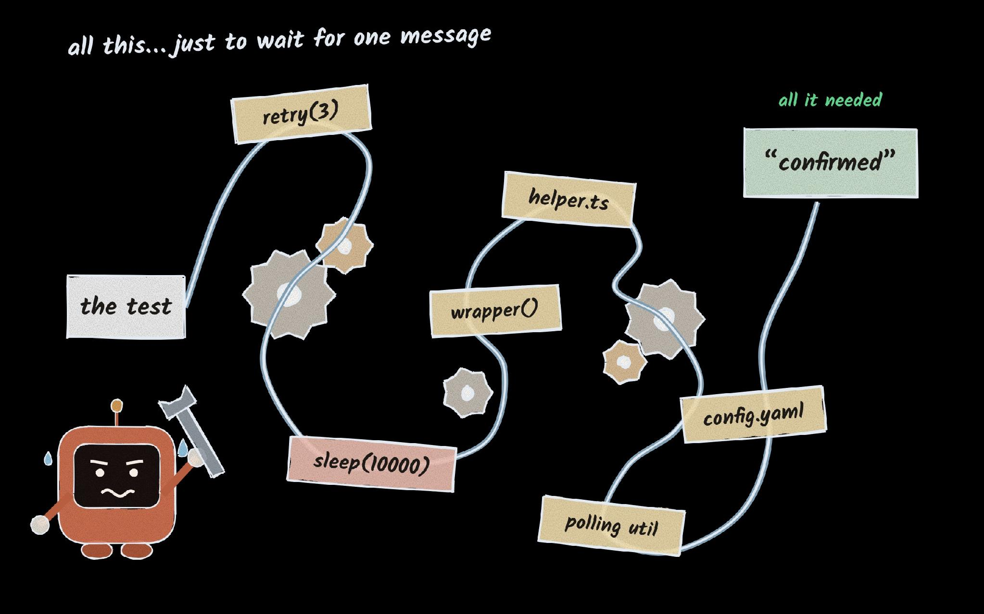
Problem 2 — Over Complication
THE RULE · 2 OF 4
Keep it simple
Write the minimum code that solves the task. No speculative helpers, retries or options.
TESTING EXAMPLE
Task Make the test wait for the payment.
✗ Without A retry wrapper, sleep(10000) and a new polling util.
✓ With the rule Waits for the real “confirmed” response, then one retrying assertion.
IMPACT ON YOUR TEST PROJECT
Less test code to maintain, and the real cause stays visible instead of buried under retries.
/karpathy-guidelines
Notes:
Rule 2, keep it simple. Left alone, an AI will happily build a Rube Goldberg machine: a retry helper, a fixed sleep, a config option, a polling utility. Every one of them is code your team now has to maintain, and every one hides the real problem. The checkout test needed one thing: wait for the status that says confirmed. Ask yourself: would a senior tester call this overcomplicated? If yes, simplify.

Slide 19
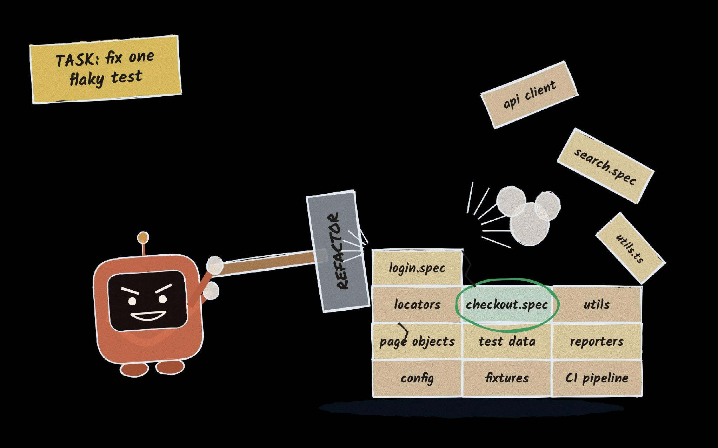
Problem 3 — Collateral Damage
THE RULE · 3 OF 4
Touch only the task
Change only what the task needs. Match the existing style. Mention other issues, don't fix them.
TESTING EXAMPLE
Task Fix checkout.spec.
✗ Without Renames locators, adds a utils file, edits login.spec too.
✓ With the rule One test changed. Same getByRole / getByTestId locators.
IMPACT ON YOUR TEST PROJECT
Small diffs reviewers can trust, and no surprise failures in tests nobody asked to change.
/karpathy-guidelines
Notes:
Rule 3, surgical changes. You ask for one flaky test to be fixed, and you get a refactor: renamed locators, a new utils file, the API client tidied up. Each change might even look reasonable, but now your reviewer has to check many changes instead of one, and something unrelated breaks next week. The rule: every changed line should trace directly back to the request. On our project: one test changed, same locators, nothing else touched.

Slide 20
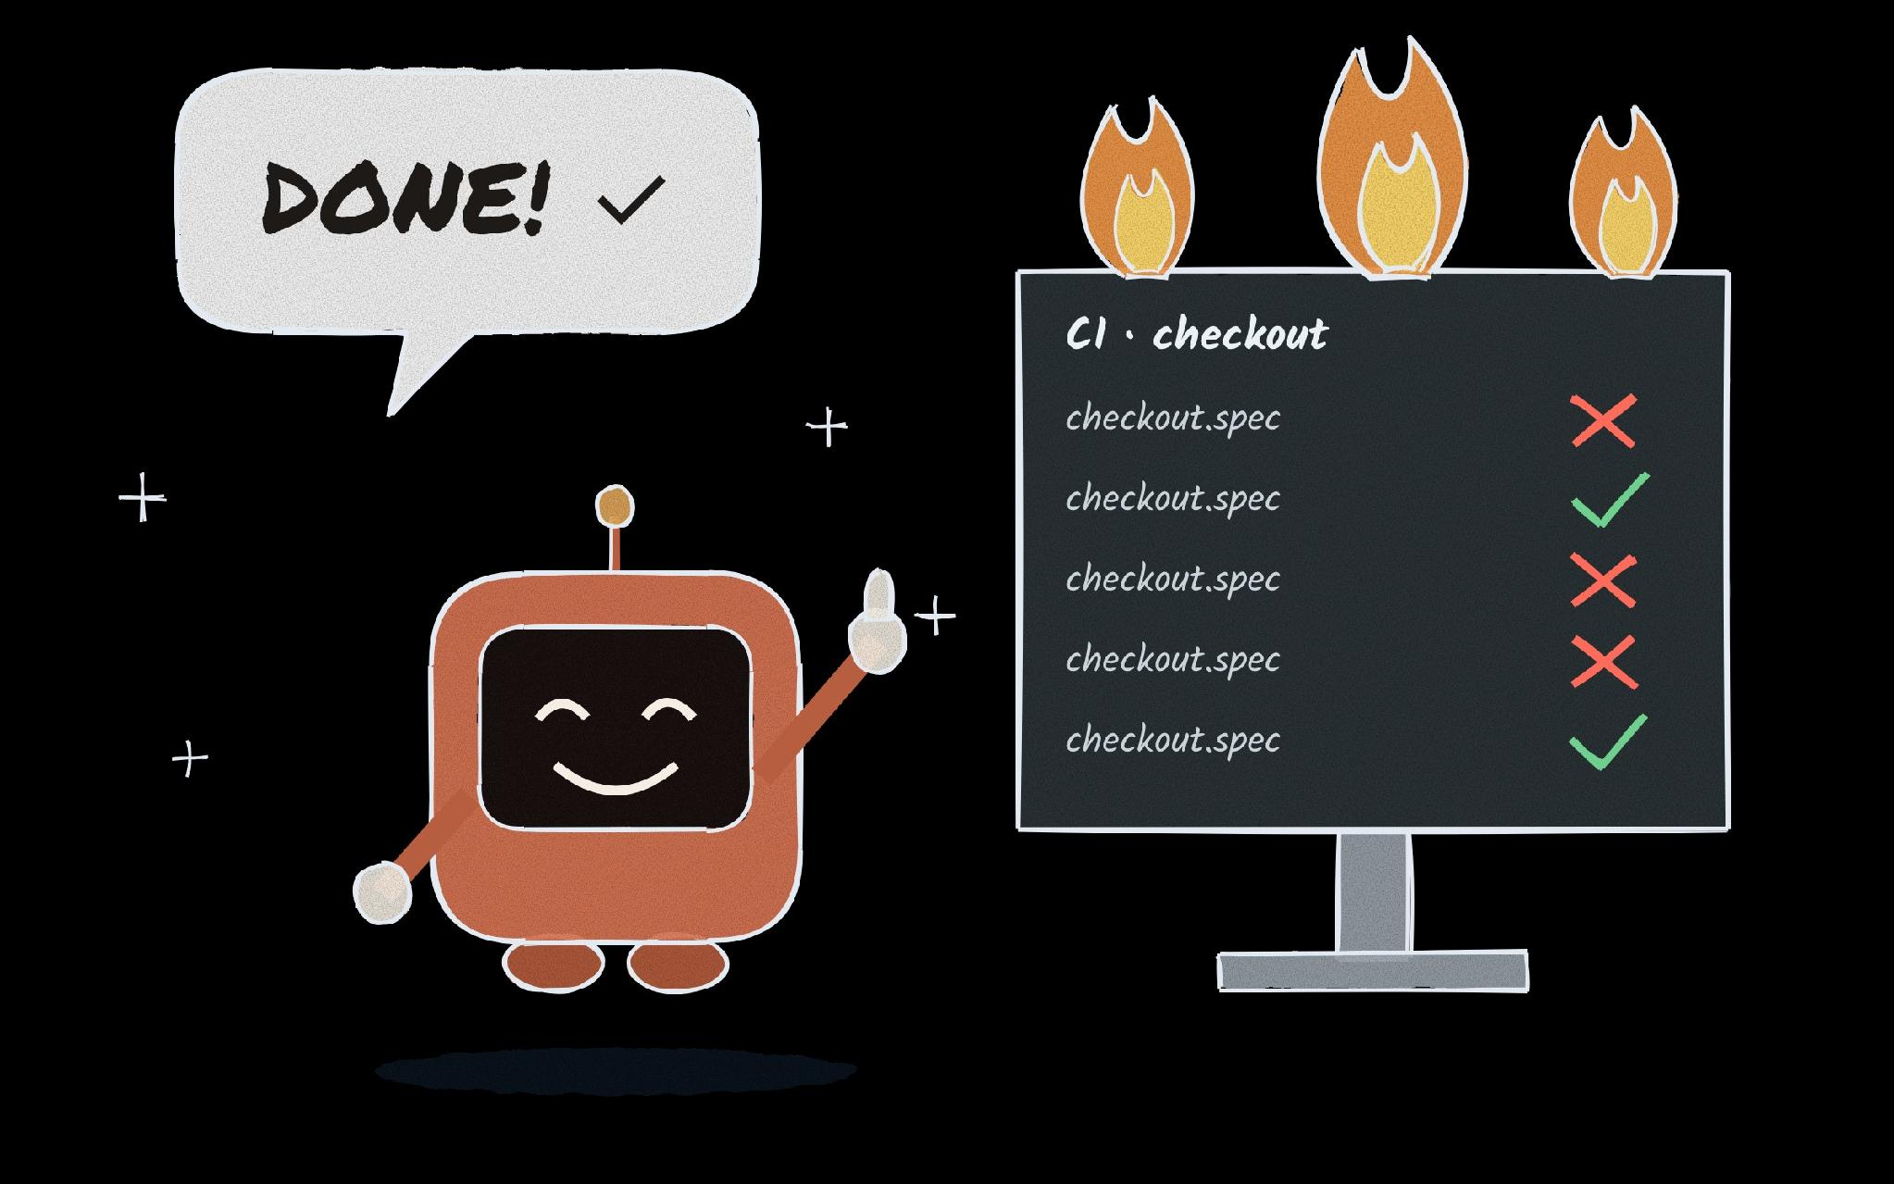
Problem 4 — “Done” without proof
THE RULE · 4 OF 4
Prove it
Define success before you start, then show the evidence, not just “done”.
TESTING EXAMPLE
Task Make the checkout test stable.
✗ Without Says “Done!” after a single green run.
✓ With the rule Runs it 30 times with --repeat-each and reports “passed 30/30”.
IMPACT ON YOUR TEST PROJECT
A green build means something again: you review evidence, not claims.
/karpathy-guidelines
Notes:
Rule 4, goal-driven execution. The most dangerous word an AI says is done. For testers this one should feel familiar: no evidence, no pass. Turn the task into a verifiable goal before Claude starts: the checkout test passes 30 runs in a row. Then ask it to show you the run, not tell you about it. With the guideline on, Claude reported passed 30 out of 30 with repeat-each. That is a claim you can check.

Slide 21
Real Problems - Real Solutions
PART 2

Slide 22
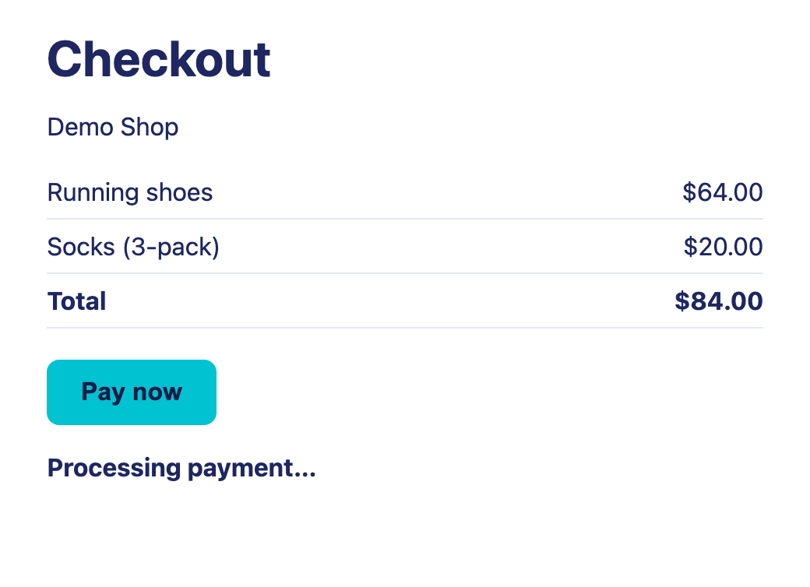




A typical QA problem: the flaky checkout test
What you see: the checkout test fails about 4 runs in 10 (Received: “Processing payment…”), then passes on a re-run
What teams usually do: add CI retries, or raise the fixed wait in the test (ticket QA-1432)
What it costs: slower releases, and nobody trusts a red build any more
Where it happens: a web shop whose payment confirms asynchronously (1–3 s, up to 8 s at peak). The app works; the test checks too early.
Fixing it with the four /karpathy-guidelines rules
1 Think first
reproduce it, watch it, read the docs
2 Keep it simple
wait for the real "confirmed" event
3 Touch only the task
one test changed, same locators
4 Prove it
10 runs in a row, also on a slow day
13

Slide 23
Step 1: Start with a good project structure
your-test-repo/
1
Start with
├─ CLAUDE.md
team rules
One person runs /init once in the test repo. It writes a first CLAUDE.md.
MEMORY
├─ .mcp.json
browser + team docs
MCP
2
Commit it
└─ .claude/
The whole team shares the same rules, and changes them by pull request, like code.
├─ skills/
team skills
SKILL
├─ agents/
test-reviewer
3
Keep personal preferences out
SUBAGENT
Each tester's own ~/.claude/CLAUDE.md, not in the repo.
└─ settings.json
hooks for everyone
HOOK
Why first: every tester's Claude now starts with the same rules, skills and tools.
Notes:
Why first: every tester's Claude now starts with the same rules, skills and tools.

Slide 24
Step 2: without your docs, Claude can only guess
The bug: payment takes 1–8 s, but the test checks once after 2 s. We asked Claude to fix it with no team docs, twice.
usual 1–3 s
busy hours: up to 8 s (our runbook)
0 s
4 s
6 s
8 s
12 s
old test checks (2 s)
A and B give up (5 s)
A · Plain prompt
toHaveText(checkoutTexts.paymentDone)
Removed the sleep (Playwright waits up to 5 s). Ran it on this laptop and said “Fixed.”
✗ Fails when payment takes 8 s.
B · + /karpathy-guidelines
the same change
…and it warned us: “only 1.5 s of slack… I haven't seen CI timings. Say if you want it.”
Honest, but still fails at 8 s.
Same code, different answers. Only your docs know the real answer: wait for “confirmed”, not a time.
Notes:
Real runs (18 October) in a copy of the repo with only the tests, the page object and test data: no CLAUDE.md, no docs, no search_docs. A (plain prompt) and B (/karpathy-guidelines) made the same change: removed the 2 s sleep from pay() and replaced the one-time read with expect(checkout.paymentStatus).toHaveText(checkoutTexts.paymentDone), which retries for Playwright's default 5 s. Both pass 20/20 on normal days and fail when the gateway takes 8 s (busy hours in the runbook). The difference is the answer: A said 'Fixed' based on local runs; B named the risk ('only about 1.5 s of slack… if CI is much slower it could still time out… I haven't seen CI timings. Say if you want it.'). Rule 1, think first, made Claude ask; the docs answer. Code and reports: demo-solutions/no-docs/.

Slide 25

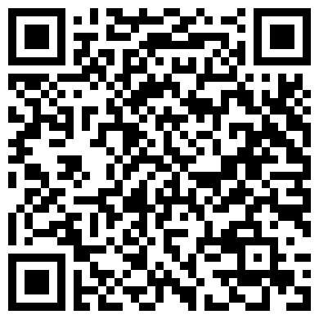


One more layer: the karpathy rules + your team's knowledge
Karpathy's four rules HOW TO WORK
think first · keep it simple · touch only the task · prove it
READ MORE
+
Your team's docs (RAG) WHAT IS TRUE
search_docs via MCP finds the runbook: wait for “confirmed”, up to 8 s
1 Karpathy's notes
x.com/karpathy
2 The skill file
github.com/multica-ai/…
+
A real browser WHAT REALLY HAPPENS
Playwright MCP watches the page: Pay → 202 → pending → confirmed
=
/fix-flaky one command, every tester
3 Why it took off
Medium
4 Most popular AI coding skills
dev.to/aws
Rules alone made Claude honest. Rules + docs made it right.
Notes:
The bridge between slide 24 and the skill. Karpathy's rules alone only made Claude admit it didn't know (slide 24). We add one more layer: our team's knowledge. /fix-flaky follows the four rules, step one searches our docs through MCP (the RAG from Part 1), and it watches the page in a real browser with Playwright MCP. Rules say how to work; the docs say what's true; the browser shows what really happens. Read more (scan the QR codes): 1 Karpathy's original notes on X, 2 the skill file on GitHub, 3 a Medium article on why it took off, 4 dev.to (AWS): the most popular AI coding skills.

Slide 26
Step 3: write the four rules down once, as a team skill
.claude/skills/fix-flaky/SKILL.md
NOW EVERY TESTER TYPES
1
Think first
> /fix-flaky
the checkout test
Reproduce it, watch it in the browser, search the docs.
2
Keep it simple
Wait for the real event, never a timeout.
Same command, same quality, for everyone on the team.
3
Touch only the task
Change only the test, in our existing style.
4
Prove it
The four /karpathy-guidelines rules, written once as steps your whole team runs.
Run it 10 times, name the docs you used.
Notes:
The real skill file lists six steps; they map onto the four rules: reproduce + watch with Playwright MCP + search_docs (think first), wait for the real event and never touch a timeout (simple), keep getByRole/getByTestId (surgical), --repeat-each=10 and report the sources (prove it). Skills combine: '/api-tests the payment API, and follow /karpathy-guidelines' wrote 6 API tests, each linked to the spec section, and refused to invent an undocumented state.

Slide 27



Step 6: four testers, four Claudes, one repo
All four testers now use these skills at the same time. How they avoid breaking each other's work:
1
2
3
4
5
Rules via PR
One task, one branch
Same guardrails for all
Every PR is reviewed
Learnings go back
Edits to CLAUDE.md, skills and hooks get reviewed like code.
Two agents at once? claude --worktree gives each its own repo copy.
Hooks (automatic checks) live in the shared settings and run for everyone.
Claude in your CI (GitHub Action) plus a human reviewer.
A new team decision becomes a line in CLAUDE.md.
Git keeps collisions small and visible: separate branches or worktrees, small tasks. Two people editing CLAUDE.md? A normal merge conflict, solved in review.

Slide 28
The result: the fix waits for the real event, not a number
Before
fails about 4 in every 10
the original test, 10 runs
After /fix-flaky
re-run by us, 20 runs
20/20 · also passes when payment takes 8 s and 12 s
waits for the “confirmed” message, however long payment takes
✓
✓
0 s
2 s
4 s
6 s
8 s
10 s
12 s
BEFORE
Click Pay
Sleep 2 s
Read the status once
Hope it says “Done.”
AFTER
Click Pay
Wait for the server’s “confirmed” reply
Check the page says “Done.” (keeps checking)
pages/checkout.page.ts waitForTimeout(2000) → waitForResponse(… status === "confirmed")
Your repo, same result: rules in CLAUDE.md + your docs connected + a /fix-flaky skill. Every tester gets this fix.
Notes:
Real run C (18 October): /fix-flaky in the real repo (CLAUDE.md, search_docs, Playwright MCP). Before: the original test failed 15 times in 40 runs (about 4 in 10). Claude's run: 10/10, 3/3 at 7.5 s; re-checked 20/20, 3/3 at 8 s, 2/2 at 12 s.
Before: pay() clicked Pay, waited for the POST (202 = accepted, not paid), slept 2 s; the test read the status text once.
After, in the page object: pay() starts listening for the status reply whose body says "confirmed", clicks Pay, and waits for it (const confirmed = this.page.waitForResponse(res => /\/api\/payment\/[^/]+\/status$/.test(res.url()) && (await res.json()).status === 'confirmed'); click; await confirmed). In the test: await expect(checkout.paymentStatus).toHaveText(checkoutTexts.paymentDone) keeps re-reading the element until it says Done., because the page updates the text just after the reply arrives. Plus a check of the Payment confirmed box. Full files: demo-solutions/fix-flaky/.

Slide 29
What made the difference
WHAT CLAUDE HAD
WHAT IT DID
RESULT
Removed the sleep and said “Fixed.”
✗ Fails on a busy day (8 s)
Just a prompt
The same fix, but warned us it didn’t know the CI timings.
✗ Still fails at 8 s, but honest
Prompt
+ karpathy rules
/fix-flaky waited for the real “confirmed” reply, in our page object, in our style.
✓ 20/20, passes at 8 s and 12 s
karpathy rules
+ our docs (RAG)
+ browser
Rules make Claude honest. Your docs make it right. A team skill makes it the same for everyone.
Notes:
The conclusion of Part 2, from the three real runs (18 October) on the same flaky test. 1) Just a prompt, no docs: removed the 2 s sleep, Playwright's 5 s retry, said 'Fixed'; fails when payment takes 8 s. 2) Same + /karpathy-guidelines: identical code, but it warned: 'only about 1.5 s of slack… I haven't seen CI timings'; still fails at 8 s. 3) /fix-flaky = the four rules + search_docs (RAG) + Playwright MCP: waited for the 'confirmed' status reply inside the page object, test in the team's style; 20/20, 3/3 at 8 s, 2/2 at 12 s. Say: the message isn't the code, it's what you give Claude: rules, your knowledge, and one skill everyone uses.

Slide 30
Talk is Cheap, Show me the code
PART 3

Slide 31
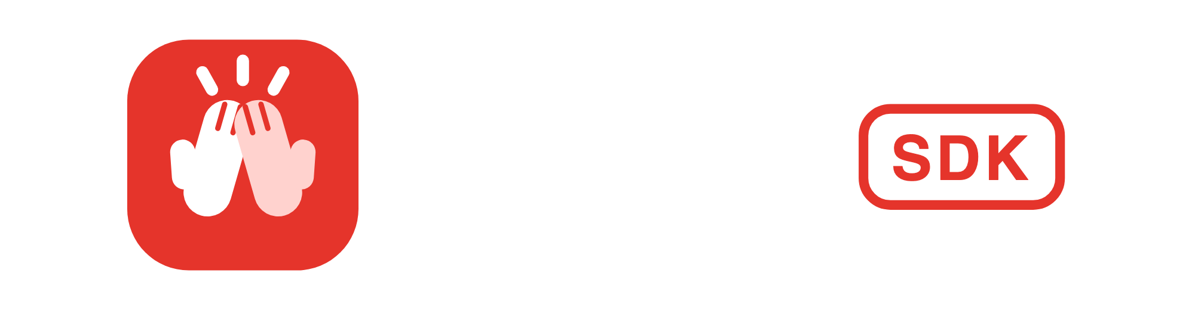
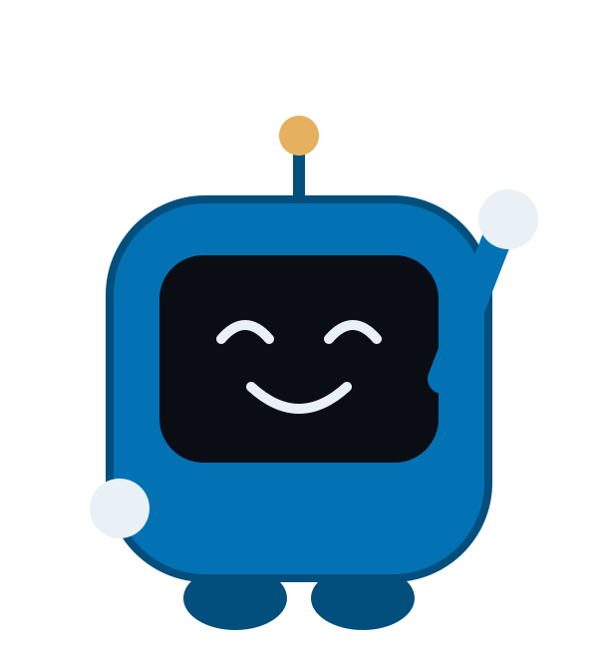
I'm the one we built.
Meet Clappy
The SDK we built at Applause. It does three jobs:
1 Writes tests from plain English. Describe it; it drives a real browser or phone (web, Android, iOS) and saves the code.
2 Keeps them running. It replays them and fixes broken locators itself.
3 Builds your framework. It turns everyone's tests into one consistent Playwright framework.
Notes:
Bridge from Part 2: you just fixed one test with Claude Code. Your team has hundreds, written by different people in different styles. Turning them into one framework by hand takes weeks. That's what Clappy does. Point at the logo: you'll see it in the left panel of our test platform in a minute.

Slide 32

When the login page changes, how many places do you fix?
TODAY: EVERY TEST HAS ITS OWN COPY
WITH CLAPPY: ONE PAGE OBJECT
Anna's cart test
Anna's test
Ben's test
Chris's test
Login form
Add to cart
Ben's sorting test
The page object each element written once
Login form
Login form
+ 10 more elements
Specs call its methods instead of repeating locators.
Clappy SDK
Add to cart
Chris's checkout test
Login form
Add to cart
Cart icon
Cart icon
Login changes → fix it in every test that logs in, one copy per test.
Login changes → fix it once, every test is fixed.
Clappy turns tests written by different people into one framework: page objects, specs, configs and CI, in standard Playwright you review like any pull request.
Notes:
Real tests from our demo on saucedemo.com (Sauce Labs' public demo shop). Anna, Ben and Chris each log in with the same three locators (username, password, Login button); Anna and Chris both click the same Add to cart button. Written separately, each test carries its own copy. Clappy builds one page object: the login is defined once and all three tests call it. Why not the alternatives: a recorder gives a flat script with locators copied into every test; AI writing tests ad hoc gives working code in whatever style, not your framework; low-code platforms lock you into their format. Clappy writes standard Playwright inside your team's own skeleton.

Slide 33
How Clappy builds the framework
Your tests go in on the left. A framework your team would have written by hand comes out on the right.
Your team's skeleton
folders, base page, fixtures, configs, CI
1
Read the tests
from plain English (Clappy), recorded, or by hand; web or mobile
2
Find the pages
the AI groups steps by screen
3
Page objects
each element once; shared parts become components
4
Name things
readable names from the AI; plain fallback without a key
5
Fill the skeleton
only the framework files the tests use
6
Type check
before you see it; anything missing is listed as a TODO
Out: page objects, specs, env configs and a CI workflow, as a pull request on your GitHub repo or a zip.
Our test platform
one click (the live demo)
Claude Code
as an MCP server
CI pipelines
the clappy CLI
Your own tools
the clappy-core library
Built with Claude Code. When tests replay, the Clappy runtime self-heals broken locators. Packages are internal for now.
Notes:
Six steps, left to right. The skeleton is your team's framework template; Clappy copies only the files the tests need. Page objects: steps are grouped by screen, every element is defined once, and parts used on 2+ pages by 2+ tests become components. The type check runs before anything is handed over. Same SDK in four places: in our test platform with one click, inside Claude Code as an MCP server, in CI with the CLI, or as a library in your own tools.

Slide 34
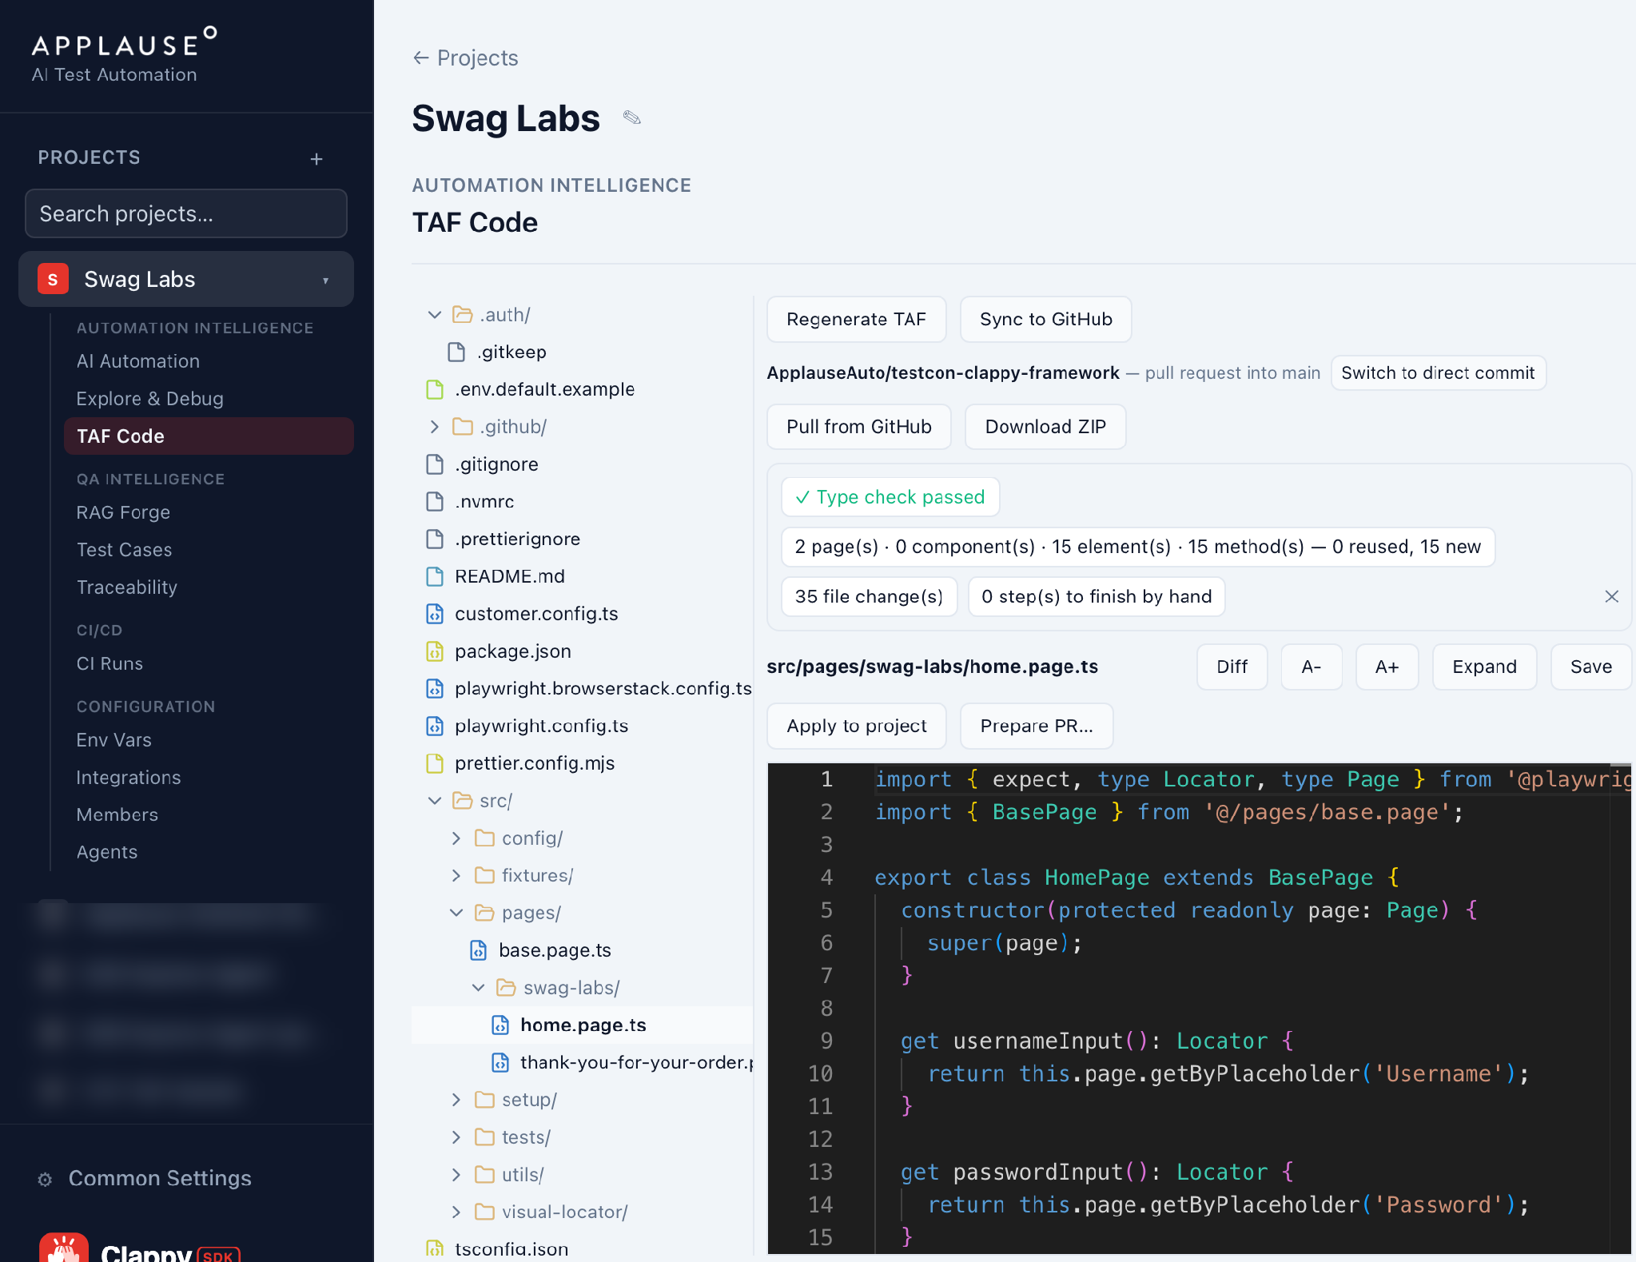

Live demo: one click in our test platform
1
Generate TAF
Anna's, Ben's and Chris's tests on saucedemo.com go in. About a minute.
1
4
2
Read the report
Type check passed. 15 elements, 15 methods, all new.
2
3
Open the page object
The login (username, password, Login button) is written once, used by all three tests.
4
Sync to GitHub
All 35 files land as one pull request, reviewed like any code.
3
Notes:
Clicks (project 'Swag Labs' is ready; generation needs no Pairing app):
1. AI Automation tab: three flows by Anna, Ben and Chris, all on https://www.saucedemo.com.
2. TAF Code tab, click Generate TAF. About a minute; talk over the progress bar.
3. The report: 'Type check passed', '15 elements, 15 methods, 15 new'. Open the page object: the login fields and the Login button, each defined once; open Ben's spec: it calls the same login methods.
4. Sync to GitHub: about 10 s, click 'View pull request'.
Rehearsal (local copy): generate 63 s, 35 files, type check passed; the generated framework passed 3/3 and 30/30 against the live site.

Slide 35
Three things to remember
1
2
3
Ground it in your docs
Write the rules down once
Keep a human on the last mile
Without them, Claude can only guess. With them, it waits for the real event.
Think first, keep it simple, touch only the task, prove it. One team skill, same quality for everyone.
Rules and fixes go through pull requests. Ask for evidence, not “done”.
a guess → “confirmed”
/fix-flaky
20/20 · reviewed PR
Speed is easy. Reliability is the real challenge.
Notes:
If you remember three things. One: ground it in your docs. Without them Claude guessed 10 seconds; with the runbook it waited for the confirmed message. Two: write the rules down once, as a team skill, so every tester gets the same quality from one command. Three: keep a human on the last mile. Rules and fixes go through pull requests, and you ask for evidence, 20 out of 20, not done. Back to where we started: speed is easy, reliability is the real challenge.
Previous slide, your first week: .

Slide 36


Questions?
Set it up, connect it to your app and your knowledge, give it rules, and keep a human in the loop.
Adonis Celestine Global Head of Automation, Applause
Taras Lytvyn AI-first Test Automation Architect, Lead SDET, Applause
code.claude.com/docs · github.com/multica-ai/andrej-karpathy-skills · qaskills.sh
Slides, code, RAG setup
github.com/ApplauseAuto/testcon-ai-cc-demo

